Slide 1

Team Simulus Traffic Simulation Project
King’s College London
https://github.com/leorohr/simulus
7CCSMGPR

Slide 2
Aims (MoSCoW Method)
Must
Individual Vehicles
Vehicle Entrance and Exit
Vehicle Behaviour
Statistics – Delay, Average Speed, Distance Travelled
Traffic Management Policies
Should
Emergency Services
User Maps
Could
Save/Load User Maps
Google Maps
Won’t
Pre-existing Traffic Simulators
7CCSMGPR

Slide 3
Project Organisation
Working Policy:
Cooperation
Democracy
Equality
Methodology:
Time Management
Iterative and Incremental
Emphasis on feedback
Flexible Roles:
Research and Design
Developer – GUI, Model Implementation
Documentation Analyst
Collaboration:
Meetings, GitHub, Facebook, WhatsApp
Peer Assessment and Conflict Resolution:
Voice, Vote, Resolve
7CCSMGPR

Slide 4
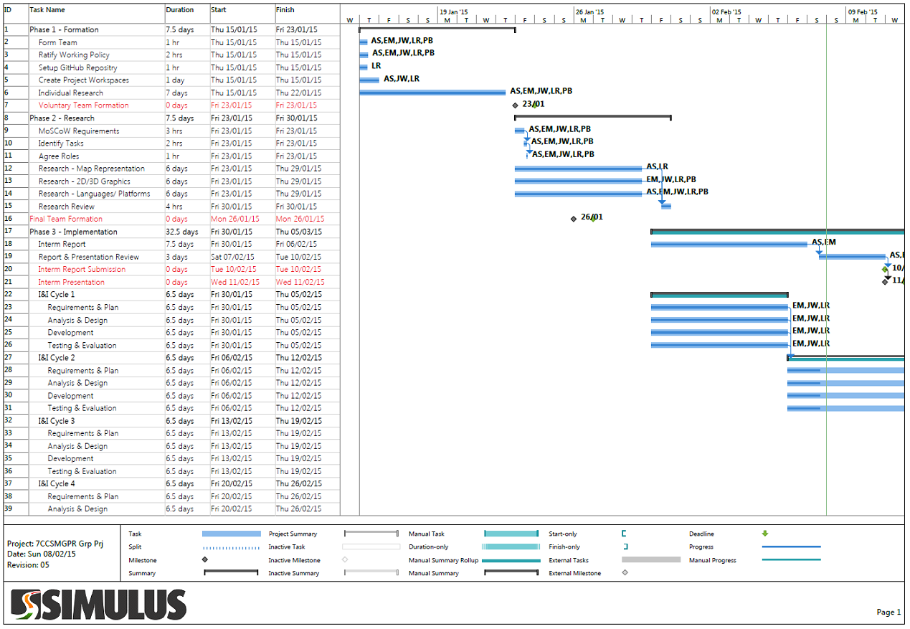
Project Progress
7CCSMGPR

Slide 5
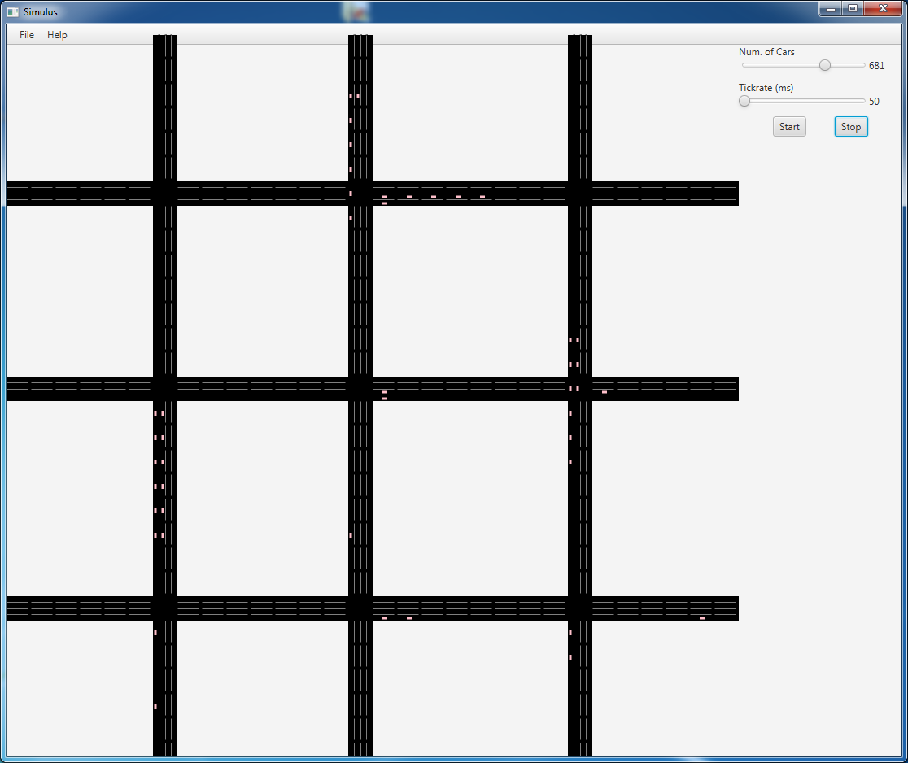
Project Demonstration
7CCSMGPR

Slide 6
Questions?
7CCSMGPR

